Slide 1

Mini Project-I (K24MCA18P) Odd Semester Session 2024-25
CLEANING ZONE
Satyjeet Kumar and 2426mca1696
Sanidhya Garg and 2426mca534
Saurabh Kumar and 2426mca1567
Project Supervisor:
Divya Singhal
Assistant Professor

Slide 2
Content
Introduction (1 slide)
Literature Review (2 slides)
Objective of the Project (1 slide)
Technology
Hardware Requirements (Development Environment, Server requirement (if required), Client requirement (if required).
Software Requirements (Language and Platforms like Frameworks, VS code, Android Studio and Jupyter notebook etc. )
Modules (2-3 slides)
Workflow (1 slide)
Reports (For Example: Project : Student Monitoring System, so reports like: Student Marks, Subjects, companies visit, and student appears in placement etc.)
References (1 slide)
Notes:
Font Styles: Times New Roman + Font Size: 25

Slide 3
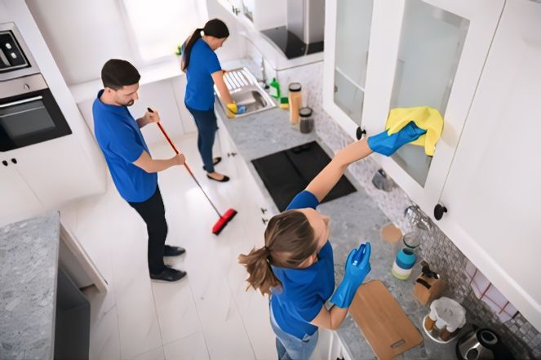
Introduction
Welcome to Cleaning Zone, your ultimate home cleaning companion! In today’s fast-paced world, keeping your home clean and organized can feel overwhelming. That’s where we come in!
Cleaning Zone is designed to simplify your cleaning routine and make maintaining a spotless home easier than ever. With our user-friendly interface, you can schedule cleaning tasks, track your progress, and receive personalized cleaning recommendations tailored to your home’s unique needs.
where we believe a clean home is a happy home! We are dedicated to providing exceptional home cleaning services tailored to meet your unique needs. With our experienced team and commitment to quality, we take the hassle out of cleaning so you can focus on what truly matters.
Notes:
Font Styles: Times New Roman + Font Size: 25

Slide 4
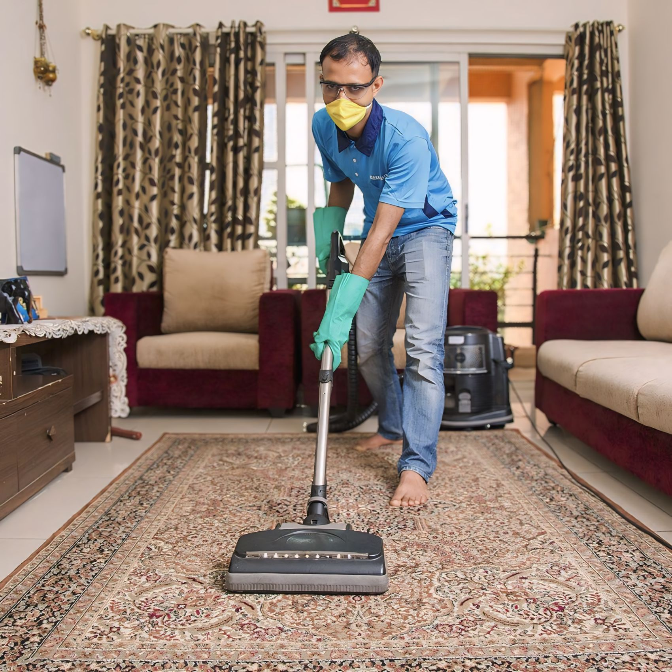
Key Concept
User-Friendly Interface: An intuitive design that allows users to easily navigate, book services, and manage appointments.
Service Options: A variety of cleaning services (standard, deep cleaning, move-in/out cleaning) that users can choose from based on their needs.
Booking System: A straightforward scheduling system that allows users to select dates and times for cleaning services.
Pricing Transparency: Clear pricing information with breakdowns for different services and any additional fees.
Notes:
Font Styles: Times New Roman + Font Size: 25

Slide 5

Benefits&Challenges
Benefits:
Convenience: Users can schedule cleaning services at their convenience, saving time and effort.
Variety of Services: Offers different cleaning options tailored to specific needs (e.g., deep cleaning, eco-friendly services).
Transparency: Clear pricing and user reviews build trust and help users make informed decisions.
Challenges:
Market Competition: Many cleaning services already exist, making it difficult to stand out.
Quality Control: Ensuring consistent service quality from cleaners can be challenging and requires effective oversight.
User Trust: Building trust with users, especially regarding safety and reliability, is crucial and can take time.
Notes:
Font Styles: Times New Roman + Font Size: 25

Slide 6
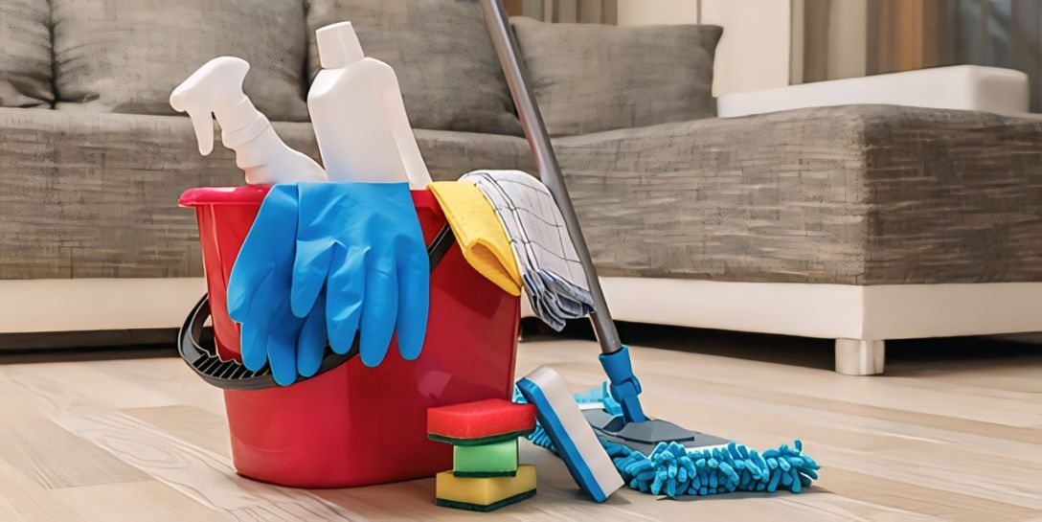
Objective of the Project
Provide High-Quality Cleaning Services:
Deliver exceptional cleaning services that meet or exceed customer expectations,
ensuring customer satisfaction and fostering repeat business.
Enhance Customer Convenience:
Offer flexible scheduling options and customizable cleaning plans to accommodate
the diverse needs and preferences of clients, making the cleaning process convenient
and stress-free.
Build Trust and Reliability:
Establish a reputation for reliability and professionalism by hiring experienced
staff, implementing thorough training programs, and maintaining open
communication with clients.
Create a Positive Workplace Culture:
Foster a supportive and motivating work environment for employees, emphasizing training, recognition, and opportunities for professional growth, leading to higher employee satisfaction and retention.
Notes:
Font Styles: Times New Roman + Font Size: 25

Slide 7
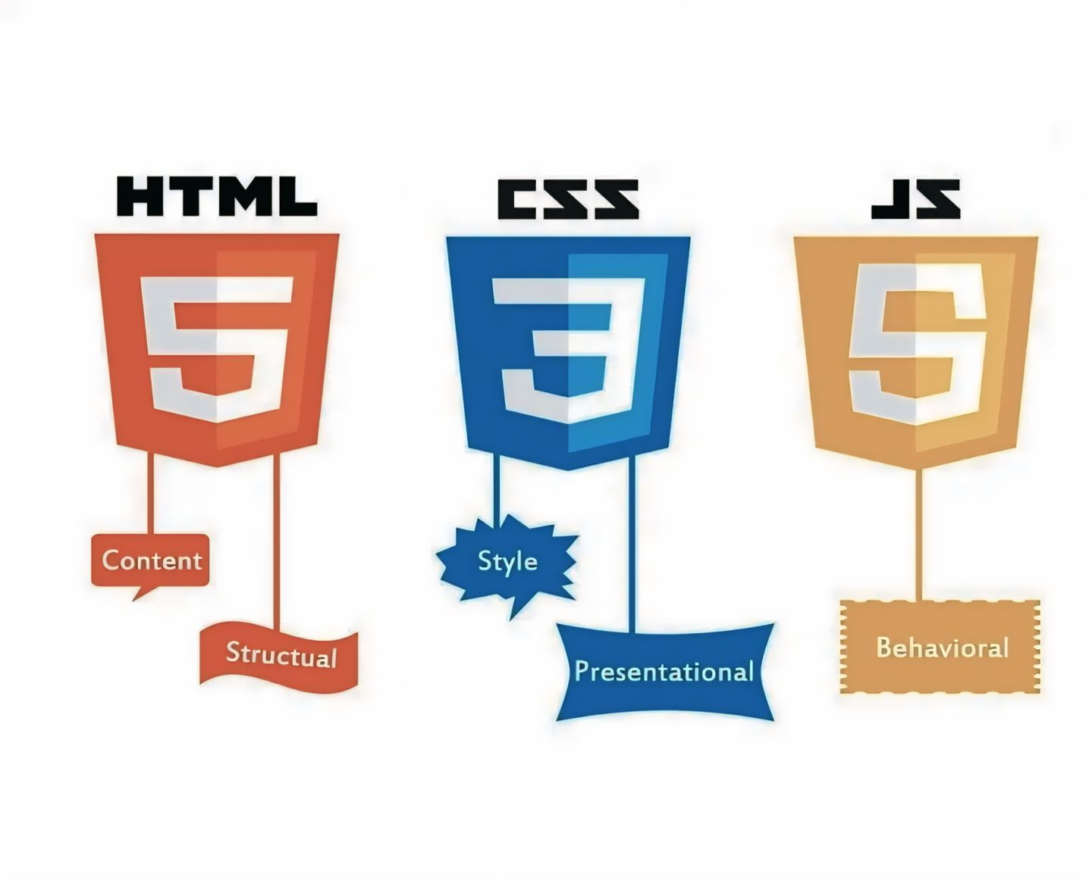
Technology (Software Requirements)
Front-End Development : The front-end (or client-side) is what users interact with. This part of the website should be dynamic, responsive, and visually appealing.
Technologies:
HTML5: Structure and layout of the web pages.
CSS: Styling of web pages, including layouts, fonts, colors, and responsiveness.
Framework: CSS
JavaScript: Adds interactivity to the website (e.g., forms, animations, etc.).
Framework/Library: Use JS for building dynamic and fast web interfaces.
js: Offers a component-based architecture ideal for building reusable UI elements.
Back-End Development :
PHP
Database (Storage)
The database is used to store persistent data such as user information, posts, or product listings.
Technologies:
SQL Databases:
MySQL: Widely used relational database management system.
Notes:
Font Styles: Times New Roman + Font Size: 25

Slide 8

Modules
1. User Authentication Module
Sign-Up/Login: Allow users to create accounts and log in using email, social media accounts, or phone numbers.
Profile Management: Enable users to manage their profiles, including personal information, addresses, and payment details.
2. Service Selection Module
Service Catalog: Display various cleaning services (e.g., regular cleaning, deep cleaning) with detailed descriptions and pricing.
3. Booking and Scheduling Module
Calendar Integration: Provide a calendar view for users to select available dates and times for cleaning services.
Booking Confirmation: Send notifications confirming booked appointments and reminders before the scheduled cleaning
Notes:
Font Styles: Times New Roman + Font Size: 25

Slide 9
Modules (Contd.)
04. Help and Support Module
Customer Support: Include options for users to contact customer support via chat, email, or phone.
Notes:
Font Styles: Times New Roman + Font Size: 25

Slide 10
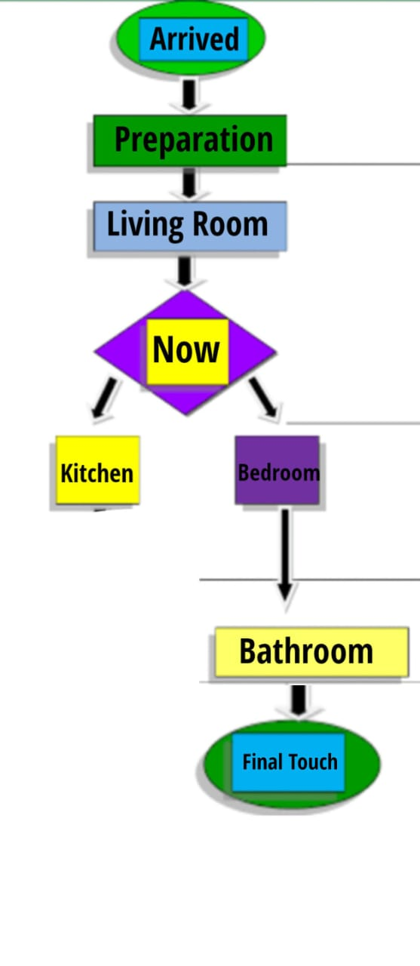
Workflow/Gantt Chart
User Registration/Login
Start
User creates an account or logs in
Service Selection
User selects type of cleaning service (e.g., standard, deep clean)
Scheduling
Payment Process
Booking Confirmation
Service Execution
Post-Service Feedback
Customer Support
If any issues arise, user accesses support options
Support resolves any complaints or questions
End
User logs out or continues to browse for additional services
Notes:
Font Styles: Times New Roman + Font Size: 25

Slide 11

Reports
1. Sales Report
Overview: Summarizes total sales over a specified period (daily, weekly, monthly, quarterly, yearly).
2. Customer Report
Overview: Provides insights into user demographics and behavior.
3. Service Utilization Report
Overview: Analyzes which cleaning services are most popular among users.
4. Employee Performance Report
Overview: Evaluates the performance of cleaning staff.
5. Customer Feedback Report
Overview: Aggregates feedback from customer reviews and ratings.
Notes:
Font Styles: Times New Roman + Font Size: 25

Slide 12

References
1. Market Research Reports
IBISWorld: Provides detailed industry reports on the home cleaning service sector, including financial benchmarks and competitive analysis. IBISWorld - Home Cleaning Services in the US.
2. Competitor Analysis
HomeAdvisor: A platform that connects consumers with cleaning service providers. Review their business model and customer engagement strategies.
Handy: A home cleaning and handyman service platform. Analyze their booking process and customer interface.
Notes:
Font Styles: Times New Roman + Font Size: 25

